Slide 1
Communication Part 3A Assignment: Design and submit the slide deck
(5 Simple Ways to Make Your Home More Eco-Friendly)

Slide 2

1) Why eco friendly Home Matters ?
Eco-friendly homes help reduce carbon footprints, lower utility bills, and preserve natural resources for future generations
Eco friendly house keeps the environment clean and we all can breathe fresh air

Slide 3
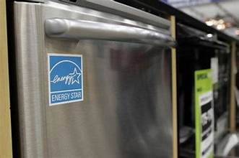
Use Energy-Efficient Appliances
Energy-efficient appliances reduce energy consumption and save money on utility bills.

Slide 4
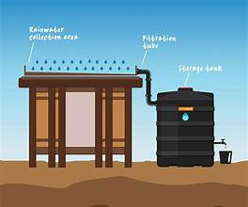
Reduce Water Usage
Install water-saving fixtures and collect rainwater to reduce water consumption.

Slide 5

Use Eco-Friendly Cleaning Products
Natural cleaning products are less harmful to the environment and reduce toxic chemicals in your home

Slide 6
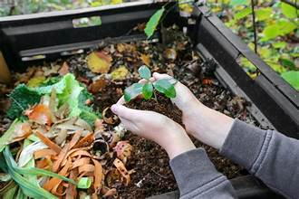
Recycle and Compost
Recycling reduces waste, and composting turns organic waste into useful fertilizer for gardens.

Slide 7
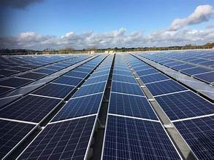
Install Solar Panels
Solar panels harness the power of the sun to provide renewable energy for your home.

Slide 8

Benefits of Eco-Friendly Living
Lower utility bills, cleaner environment, healthier lifestyle, and reduced carbon footprint.

Slide 9
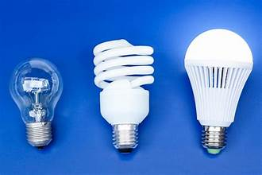

How to Get Started
Start by making small changes: switch to energy-efficient light bulbs, recycle, and reduce water use.

Slide 10
Conclusion
Making small eco-friendly changes in your home can lead to big environmental impacts over time.

